Slide 1
Two-Sigma/Renthop Kaggle Machine Learning Project
Team: [] (NULL)
Ray (Xu) Gao,
Tommy (Yaxiong) Huang,
Scott Edenbaum,
Dodge Coates
Notes:
Opening slide

Slide 2
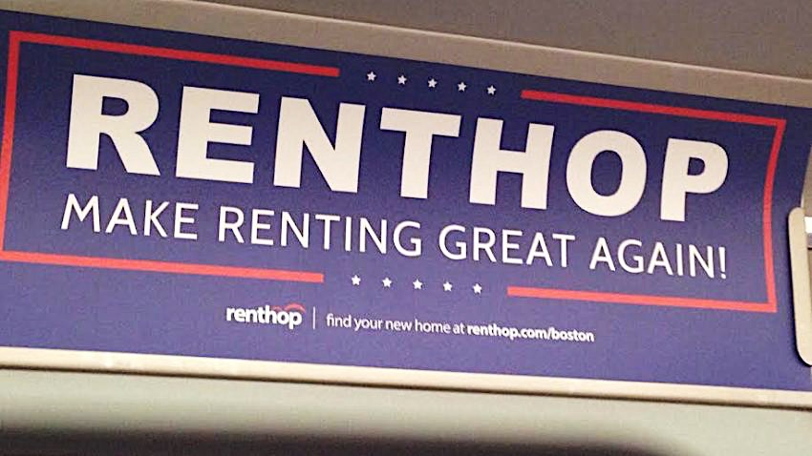
Table Of Contents
Overview
Research
Formulate approach to project
Execution
Feature pre-process
EDA
Feature selection
Model development
Model structure
Results

Slide 3
Project Workflow
Renthop Project
Initial Pre-Processing
Research
EDA & Visualizations
Feature Selection
Train/Tune Model
Interpret Results
Manipulate Data
Ask Questions
Score Models against test data
Model Error
Make Decisions
Model Stability
Good Results

Slide 4
Research
Kaggle Kernels
Inspect sample data set
Define problem
Supervised machine learning
Inspect website – add screenshot of Renthop listing page
What is interest level? What does it mean?
Base assumptions? Expectations for high/medium/low interest property
Notes:
Next slide is renthop website
Checked website to understand structure of ’features’

Slide 5
Renthop Listing
Examining Renthop’s listing page
18 Distinct Features, and an input box

Slide 6
Formulate Approach
Work in python
Why?
Personal preference, portability, large Machin learning development community
JSON data
Parse images

Slide 7
Property Map Swarmplot
Latitude
Longitude
Notes:
I know this overlaps with EDA
one of the first things we did was graph lat/long to look for obvious trends/clustering
But no good results!

Slide 8
Execution
Feature Pre-Process
Assume least important features:
Building_id, manager_id, listing_id
Display_address, street_address
Images?
created
Downloading and parsing ~83gB image data
Use EXIF.py, PILLOW, OS packages to extract info
Graph latitude/longitude
Notes:
Initially assumed large impact from lat/long

Slide 9
Derivative Features
Manager_count
Building_count
Word_count
Word_diversity
Dummify
Number_distinct
Sentiment
Image_count, Avg_brightness, Avg_luminance, Avg_filesize…
Etc.

Slide 10
Manager Count
Notes:
Right image is slightly zoomed in

Slide 11
EDA
Price
log Transformation
Bathrooms
Bedrooms
Word count

Slide 12
Price – Kernel Density
Notes:
Point out low interest

Slide 13
Base Factors Visualizations
Notes:
TRANSITION TO PRICE KERNEL DENSITY IMAGE ON NEXT SLIDE

Slide 14
EDA cont.
Distinct “Features” – distribution
Dogs & Cats – Low importance
Interest vs Value
Unique “Features”
Transformed to count
Limited impact from sentiment analysis
Notes:
Change Remaining to Unique

Slide 15
Cats & Dogs

Slide 16
EDA cont.
Images
RGB
Average image size
Brightness, Luminance
Average image count
Metadata ratio
Pixel Height, Pixel Width

Slide 17
Image EDA Visualizations

Slide 18
EDA cont.
Manager count
Log transform
Building count
Log transform

Slide 19
(Initial) Feature Selection
”Trial” Feature Selection
Initially select 5 features:
Price, Bathrooms, Bedrooms, Latitude, Longitude
Form benchmark
Compare against Price, Bathrooms, Bedrooms
Extra Tree classifier for Feature Selection
Orders Feature Importance
Notes:
trial used logit + random forest

Slide 20
Feature Importance
Notes:
Includes first batch of ‘generated’ features
Price is #1
Images very important
Point out luminance/brightness correlation - > might negatively affect rankings

Slide 21
Feature Importance: Revised with Additional Derivative Features
Notes:
Second Feature importance plot
Includes all generated ’derivative’ features
Point out change, avg imagzesize is #1, not price

Slide 22
Model Development
Stacking Model
Not optimized
Voting Classifier
Fast but unstable
Artificial Neural Network
Very Long Processing time

Slide 23
Model Structure
Stacking Model – each classifier’s result -> next classifier’s input
Logistic Regression, KNN, Gradient Boosting, Random Forest, Ada Boost
Results passed to XG Boost
Copied underlying model code
Not optimized, slow
Discovered stacking model library 2 days ago
Notes:
Note overfitting with Random Forest
Adjust minimum sample leaf above
Sentiment score - basic models

Slide 24
Stacking in 5 Steps
Partition train set into 5 test sets (aka Folds)
Create empty data frames train_meta and test_meta
row Ids & fold Ids from training dataset
For each test fold, combine remaining 4 folds as training fold
Predict results for given fold and save inside train_meta
Fit each base model to full training dataset
Predict results on test dataset, save inside test_meta
Fit a new Model, S (Logistic Regression, XGBoosting, etc.) to train_meta using M1, M2, … as features
Optionally, include other features from the original training dataset or engineered features
Notes:
#3 - note results are for each base model

Slide 25
Model Cont.
Voting Classifier
Easy way to combine models
Softweight – weighted average amongst models
Logistic Regression, Random Forest, Naïve Bayes, Decision Tree, Gradient Boost, Ada Boost
Fast! But unstable
Stepwise process generates optimized linear combination of underlying models

Slide 26
Models
Artificial Neural Network
Tensorflow
Theano
Structure
Input layer
300 nodes, Sigmoid activation function
2 Hidden layers
50 nodes, Sigmoid activation function
Output layer
3 nodes, softmax activation function
Multiple mutually exclusive classes
Downside - Process time

Slide 27
Results
Include all ”Important” features
Omitting seemingly useless and highly correlated features
Decrease dimensionality
Decreases overall model performance
Why?
Initial process we ignored building id, manager id, description, Latitude, Longitude, Created
Manager id, description id added
Model improved
Ultimately added Created (dates), Latitude, Longitude

Slide 28
Kaggle Score Submissions
Notes:
Stacking Model
Vote Classifier
Neural Network
2nd voting, fewer variable selected
Linear Combination with NN and Vote
NN& vote: all features
vote model with top 12 features
vote more features
neural network with all new features without lat long created
vote with lat long id create
Neural Network with all features, including lat, long, building Id, created

Slide 29
Conclusions and Insights
Group Cohesion
Organized github repo
Discuss strengths & weakness
Concurrent Development
Assign parallel tasks during development
Simultaneous development
feature engineering
EDA
Model Deployment
Parameter Tuning
Development Environment
Ipython notebook
Python library is very powerful
Running models in terminal
Python is incredibly powerful for machine learning

Slide 30
Additional Tools
Subplot – display multiple histograms in same image
EXIF.py – read image metadata
PILLOW (aka PIL) – basic image processing
JSON – convenient file format
Very well supported within Pandas
SSH, Screen – run models and test various code remotely
Make – consistent data processing
OS – file processing
Git – version control
Emacs, Sublime, iPython Notebook

Slide 31
Notes:
Ending slide is just a blank slide

